Slide 1

CSE-299
Dietary: a Cloud-based Nutriment & Fitness Assistant(fact-based) Android App for Bangladeshi Youths.
“Presentation On Progress”
Week : 04
Presenting by : Group 1
Date: 13.08.2020

Slide 2
Outline
Recapture
Weekly Progress
Next Week Plan
Conclusion
Q/A Segment

Slide 3
Recapture
Authentication
- Registration
- Sign in
- Sign out
- Firebase Connection

Slide 4
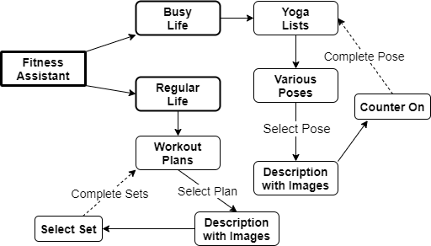
Weekly Progress :
[ Fitness Assistant ]
First, it will provide two modes like Regular Life and Busy life. According to this mode, the user can select his or her appropriate exercise plane with detailed guidance like a description with images and a set routine
Block Diagram of Fitness Assistance

Slide 5
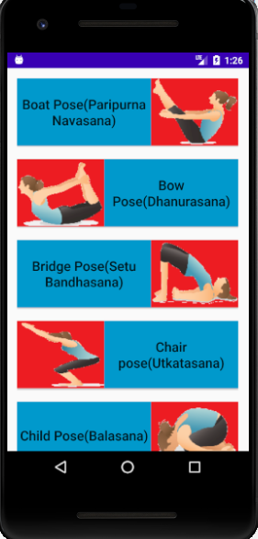
Weekly Progress :
[ Screenshot of Application]
We design 7 yoga pose for our app
Design picture according to pose
Each pose have some instructions

Slide 6
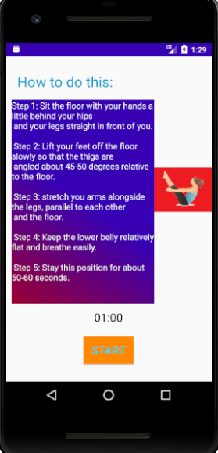
Weekly Progress :
[ Screenshot of Application]
Here we can see step by step instruction for boat pose
Which can help user to do their pose
User can start their pose to select “start” button with time counter

Slide 7
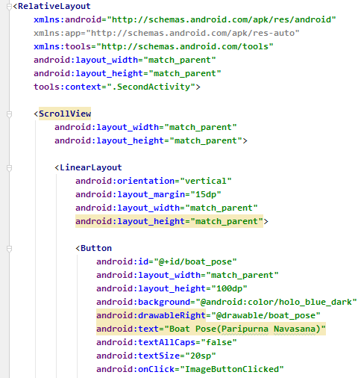
Weekly Progress
[ xml code ]
Activity

Slide 8
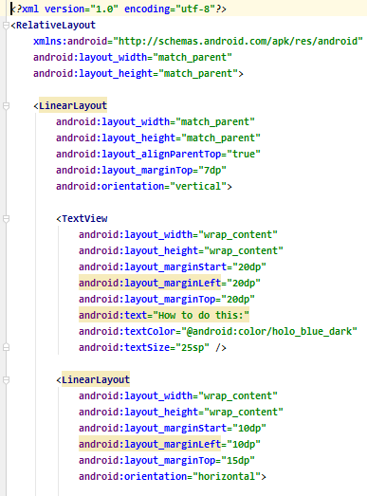
Weekly Progress
[ xml code ]
Boat
Activity

Slide 9
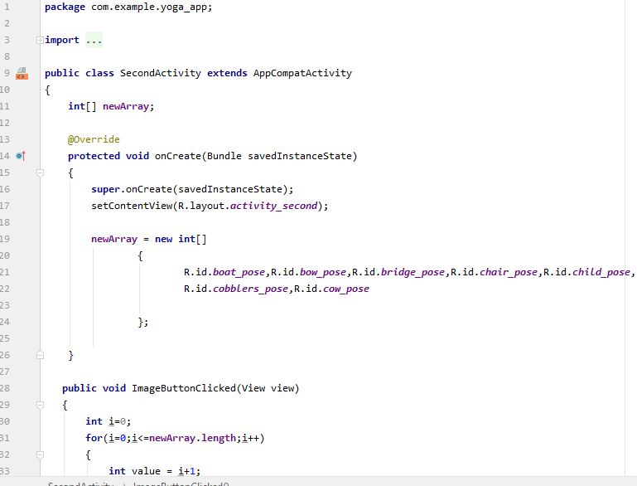
Weekly Progress
[ java code ]
Activity

Slide 10
Next week plan
Complete UI
Dataset
Fitness Assistant

Slide 11
Conclusion
We all know that “Health is wealth”. So it’s a vital fact of our life. Without a good health, you will not be able to concentrate on anything. Without good health and physical fitness life would become a burden and a tasteless thing.
This yoga exercise will help meditation and breathing can help improve a person's mental well-being. Regular yoga practice creates mental clarity and calmness.

Slide 13
Any
Questions?
Or
Suggestions!
Feel free to rise

